Slide 1


Slide 2


jQuery Dojo
James Kovacs
JamesKovacs.com
jkovacs@post.harvard.edu

Slide 3
Number of programmer-hours spent debugging integer overflows
Fun Fact
-2,147,483,648

Slide 4
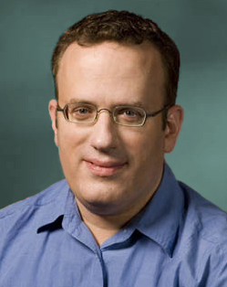
A Brief History of JavaScript
Originally designed by Brendan Eich, an engineer at Netscape
First called Mocha
Then LiveScript
Then JavaScript
Then JScript
Then ECMAScript
Don’t forget ActionScript

Slide 5
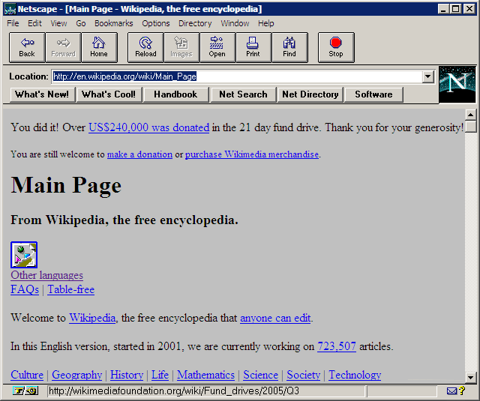

Slide 6
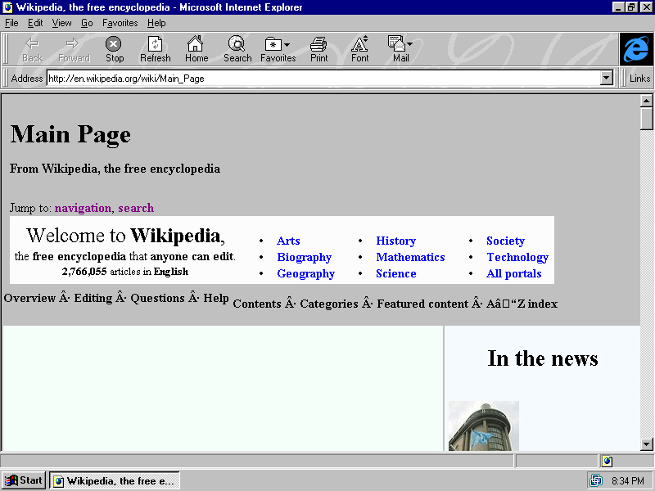

Slide 7
What’s in a Name?
Java
JavaScript
C-style language
Java naming conventions
Statically typed
Class-based OO
Poor functional support
C-style language
Java naming conventions
Dynamically typed
Prototype-based OO
Functional language
Based on Scheme and Self

Slide 8


Slide 9
Resources
jQuery (http://jquery.com)
jQuery UI (http://jqueryui.com)
jQuery Lint (http://github.com/jamespadolsey/jQuery-Lint)
jsFiddle (http://jsfiddle.net)
jQueryify (http://www.learningjquery.com/2009/04/better-stronger-safer-jquerify-bookmarklet)

Slide 10
Questions
James Kovacs
JamesKovacs.com
jkovacs@post.harvard.edu
@jameskovacs

